Slide 1
Burst Denoising with Kernel Prediction Networks
Pavel Rastopchin
Nati Joseph

Slide 2
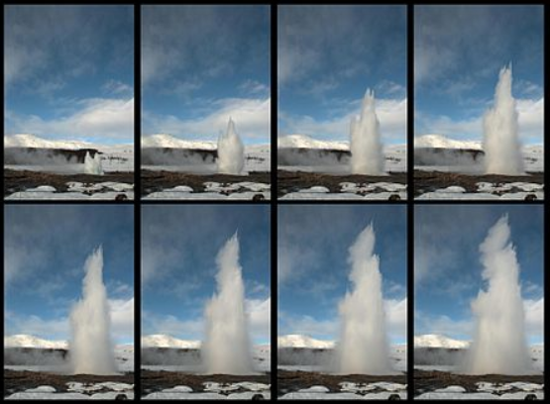
What is Burst Denoising?
Burst mode - Modern cellphones camera are able to take multiple shots in a short time.
Burst Denoising – Using the noisy images from the burst we can reconstruct the original captured scene.
In our case, an Encoder-Decoder were used to predict the filters which will denoise the images in an optimal way.

Slide 3
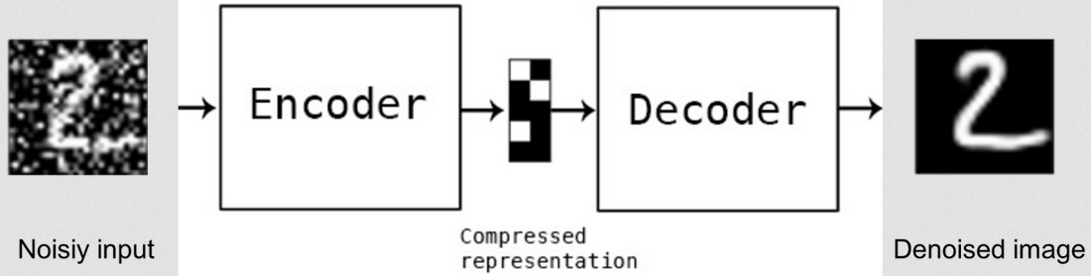
CNN - Convolutional Neural Networks
CNNs can be used to denoise images by learning mappings from noisy images to noiseless images by training on millions of examples.

Slide 4
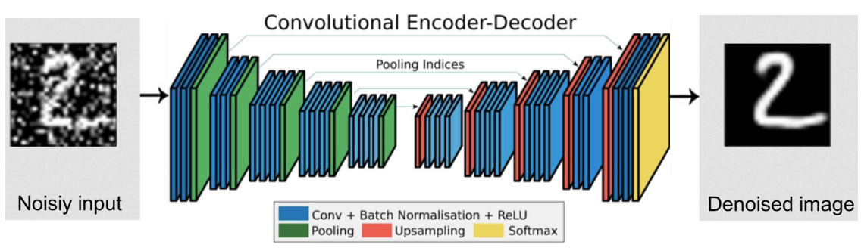
CNN - Convolutional Neural Networks
Again: Learning mappings from noisy images to noiseless images.
In current paper a different approach was used.

Slide 5
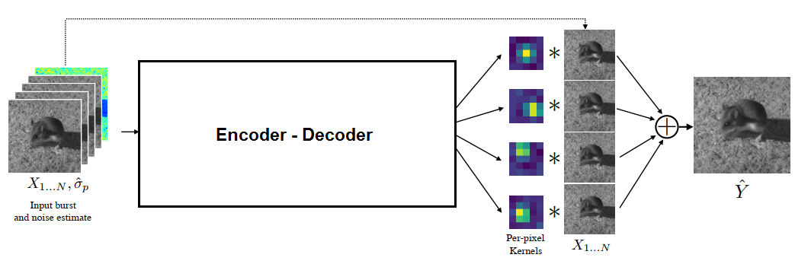
Kernel Prediction Network
Encoder-Decoder learns a mapping from noisy burst to a filters which will denoise the burst.

Slide 6
How it learns?
As we know, “learning” is basically finding “good enough” local minima of a loss function.
Basic loss function:
Weighted average of: L2 dist. of images, L1 dist. of gradients.
Г – transformation of RGB values to prevent exploding gradient.
This loss finds a local minima which is not “good enough”.

Slide 7
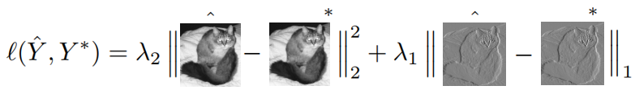
How it learns?
As we know, “learning” is basically finding “good enough” local minima of a loss function.
Basic loss function:
Weighted average of: L2 dist. of images, L1 dist. of gradients.
Г – transformation of RGB values to prevent exploding gradient.
This loss finds a local minima which is not “good enough”.

Slide 8
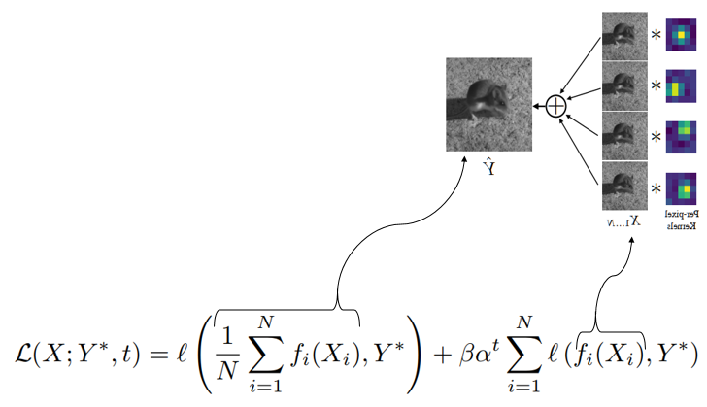
Annealed loss term
As in basic loos function we want to
minimize the distance between final
result and ground truth.
Also we want to minimize the dist. between
each frame before averaging
and ground truth.

Slide 9
Synthetic training data
Gathering ground truth data for image restoration tasks is challenging.
Burst denoising adds an additional complication.
Because deep neural networks require millions of image patches during training, it is impractical to use real pairs of noisy and noise-free ground truth bursts.
Let’s fake it!

Slide 10
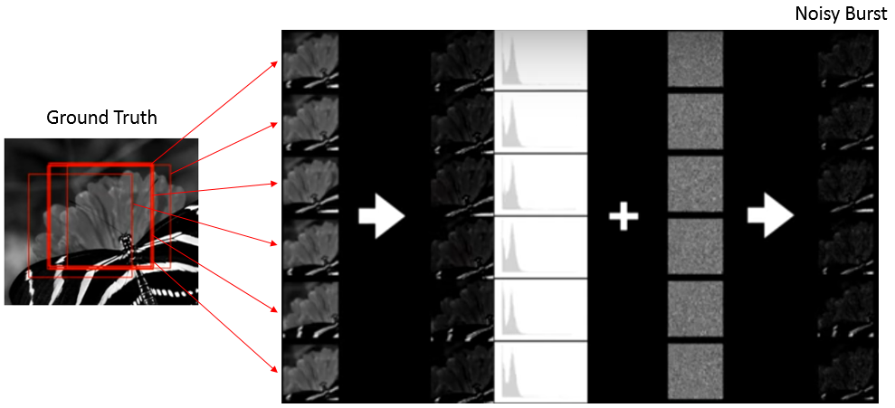
Synthetic training data
Crop randomly
Scale colors
Add noise.

Slide 11
Synthetic training data
Can we denoise real-world data by training on “fake” data?
Yes, we can

Slide 12
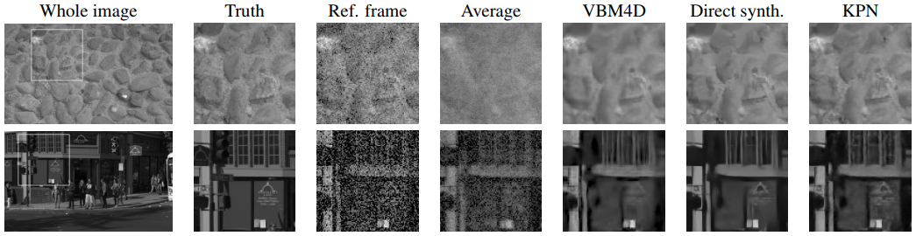
Results

Slide 13
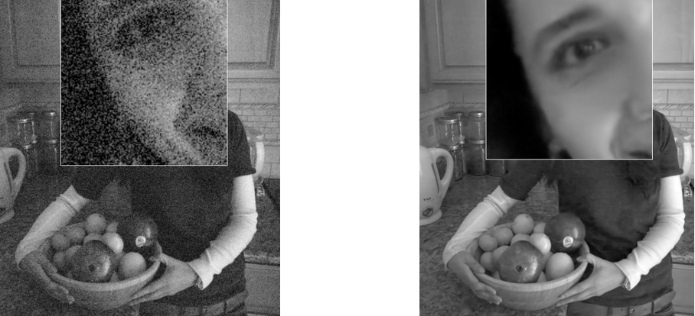
Results

Slide 14
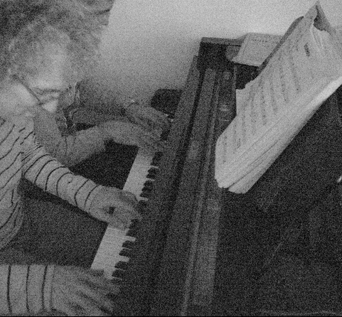
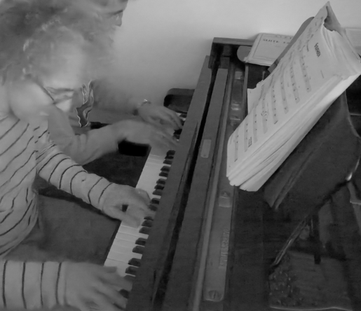
Results

Slide 15
Papers contributinos
Outperfrom state of the art algos.
Pipeline which creates synthetic data for training.

